Slide 1
Capstone Project
Bank Marketing Effectiveness Prediction Team Members Jayanth V Gowthaam Kumarasamy

Slide 2
INDEX
Problem Statement
Data Overview
Pre Processing Data
Exploratory Data Analysis
a) Univariate
b) Bivariate
Feature Engineering
Handling Class Imbalance (SMOTE)
Machine Learning Model Implementation(Naive Bayes, KNN, SVM, Random Forest, XGboost)
AUROC and ROC Curve
Conclusion

Slide 3
PROBLEM STATEMENT
The data is related to a Portuguese banking institution’s direct marketing campaigns (phone calls).
The marketing campaigns were based on phone calls.
Often, more than one contact with the same client was required, to access if the product (bank term deposit) would be (‘yes’) or not (‘no’) subscribed.
The classification goal is to predict if the client will subscribe to a term deposit (Result variable - y).

Slide 4
DATA OVERVIEW
We are provided with a Data set that contains :
Age - Age of customer.
Job - type of job customers do.
Marital - Whether a customer is married, single or Divorced
Education - Qualification of our customer.
Default – Customer has credit in default or not.
Housing - Customers have a housing loan or not.
Loan - Customer has a personal loan or not?
Contact: contact communication type.
Month: last contact month of the year.
Day of the week: last contact day of the week .

Slide 5
DATA OVERVIEW
day of week: last contact day of the week.
Duration: last contact duration, in seconds.
Campaign: number of contacts performed during this campaign
Pdays: number of days that passed by after the client was last contacted from a previous campaign.
Previous: number of contacts performed before this campaign and for this client
Poutcome: outcome of the previous marketing campaign
Y: has the client subscribed to a term deposit or not?

Slide 6
PRE PROCESSING DATA
While processing the data we tend to :
Handle the missing and null values by replacing them with the mean values and zeros.
Remove some columns if not necessary for our analysis.
Combining two columns that have high correlation and have equal effect on the output data.

Slide 7
EXPLORATORY DATA ANALYSIS

Slide 8
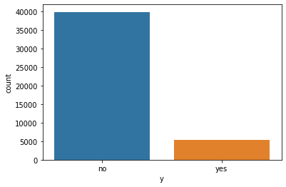
Univariate Analysis
Considering a single column in the dataset and conducting an analysis to find out the effect that the column has on the resultant variable Y.
Output variable y.
It seems most people have not subscribed to a term deposit

Slide 9
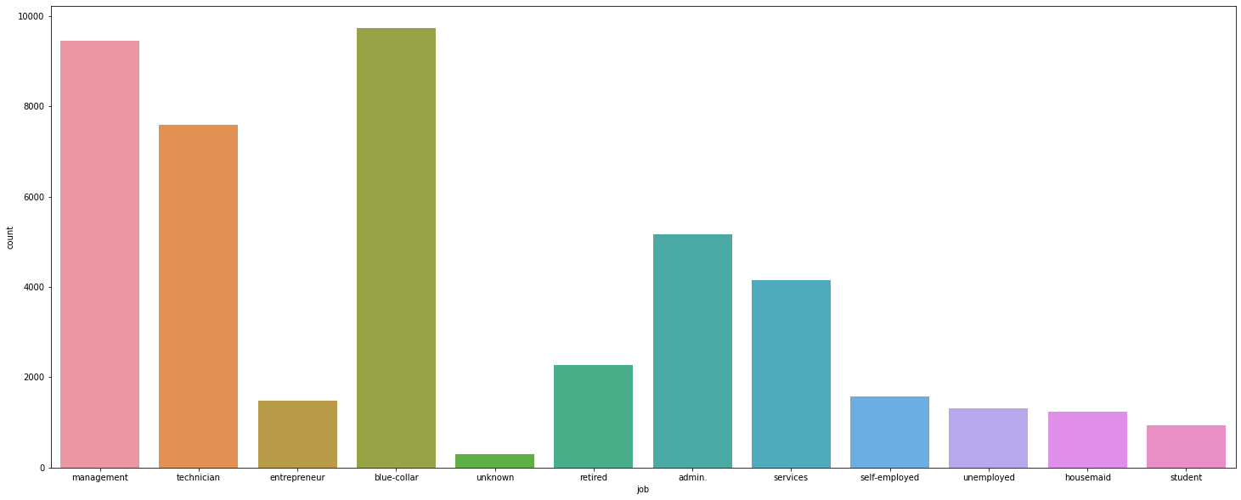
EDA (continue… )
Count of People who work in various Job categories.

Slide 10
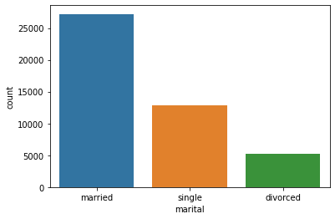
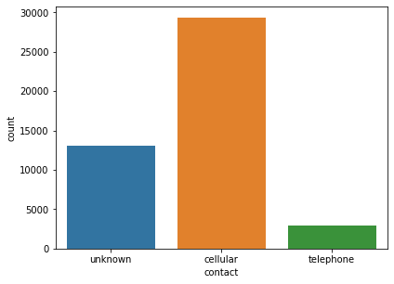
EDA (continue… )
We can infer that
1.Clients availing term deposit mostly through cellular contact, so marketing should be focussed in cellular mode
2.Clients who are reached through telephone are the least to subscribe term deposit so we should avoid telephone marketing
Count of people using type of contact
Count of people with their Marital Status

Slide 11
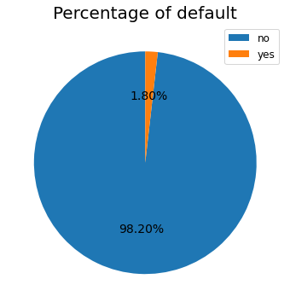
EDA (continue… )
The amount of people who owns a credit card is
shown in the form of a pie chart and we can infer that a majority of 98.2% of the people in our dataset has a credit card in default.

Slide 12
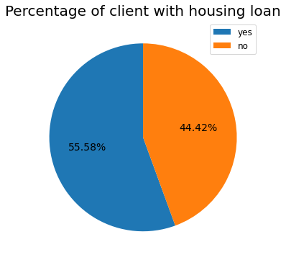
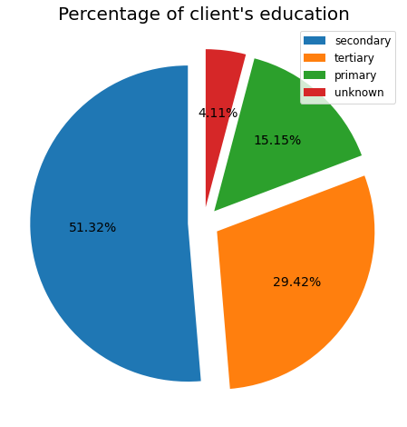
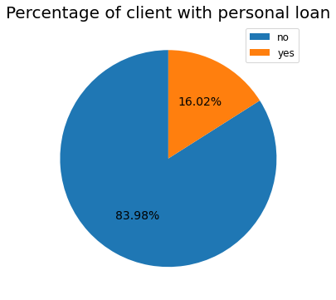
EDA (continue… )
Univariate analysis on columns like housing loan, Personal loan, Client’s education etc. we can see the pie chart displayed below and the percentages of the people having a loan and their respective education background. Not much could be inferred from this analysis so we move to Bivariate in the upcoming slides.

Slide 13
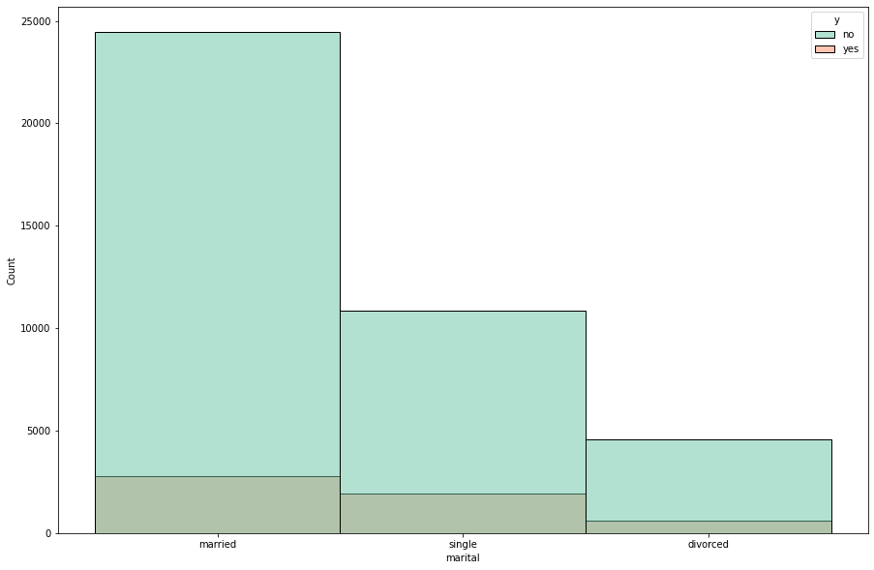
EDA - Bivariate Analysis
We can see the marital status of all people in the given dataset and how many of them have actually subscribed to a term deposit.

Slide 14
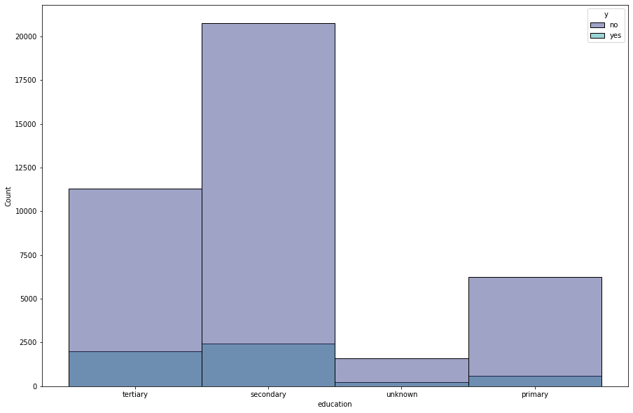
EDA - Bivariate Analysis (continue… )
Analyzing whether the education of a person determines the amount of term deposit that people subscribe to.
It shows that the clients with secondary education have subscribed the term deposit most

Slide 15
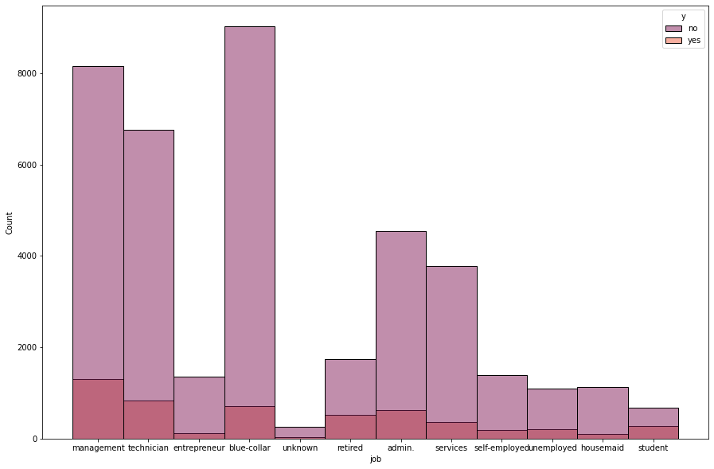
EDA - Bivariate Analysis (continue… )
Through this graph, we can understand that the clients with management jobs have availed term deposit most through marketing campaigns.

Slide 16
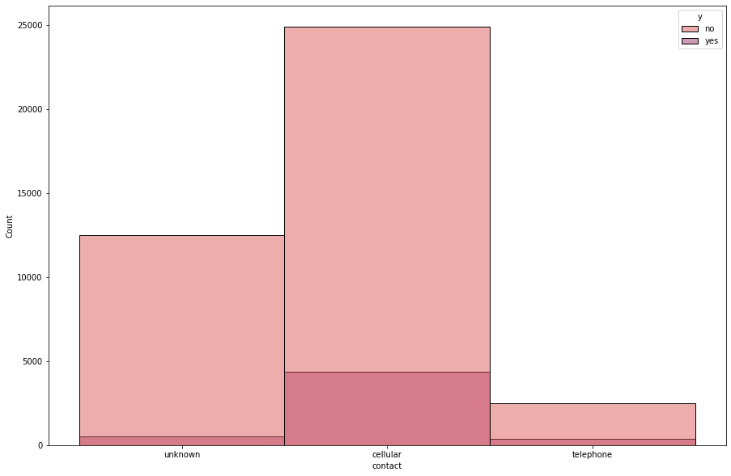
EDA - Bivariate Analysis (continue… )
Marketing through cellular contact has got more subscriptions than the rest when we compare the mode of transport and its effect on the output variable.

Slide 17
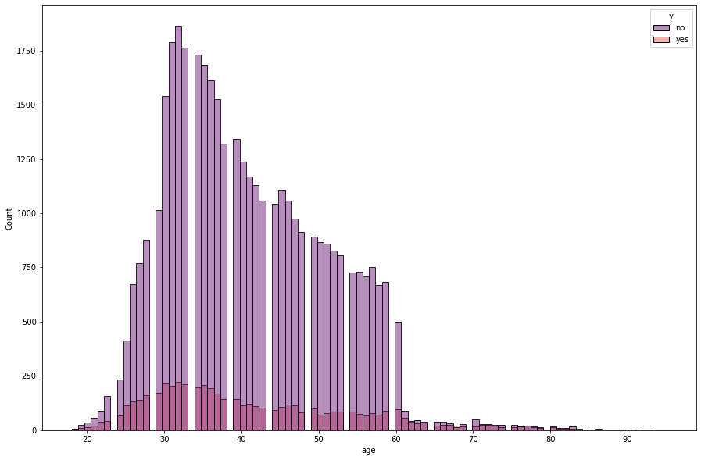
EDA - Bivariate Analysis (continue… )
We can conclude that those from age 25 to 45 are the clients who have subscribed for the term deposit.

Slide 18
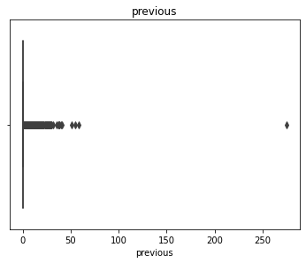
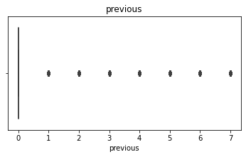
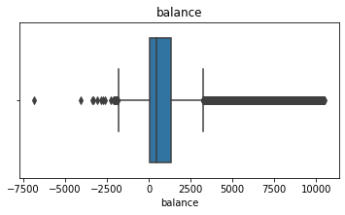
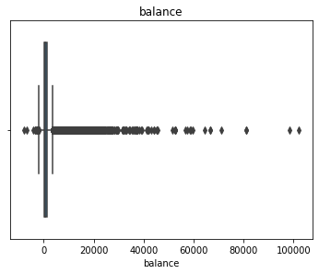
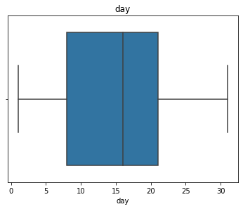
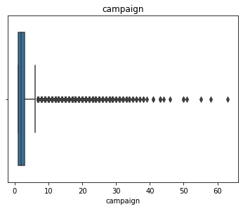
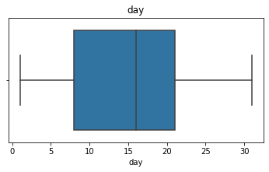
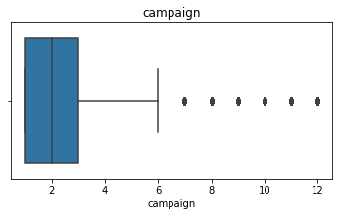
Outlier Treatment
Considering the dataset we have taken certain columns that are necessary for our analysis and have performed an outlier detection and removed them by applying Z – Score
Before eliminating outliers
After eliminating outliers

Slide 19
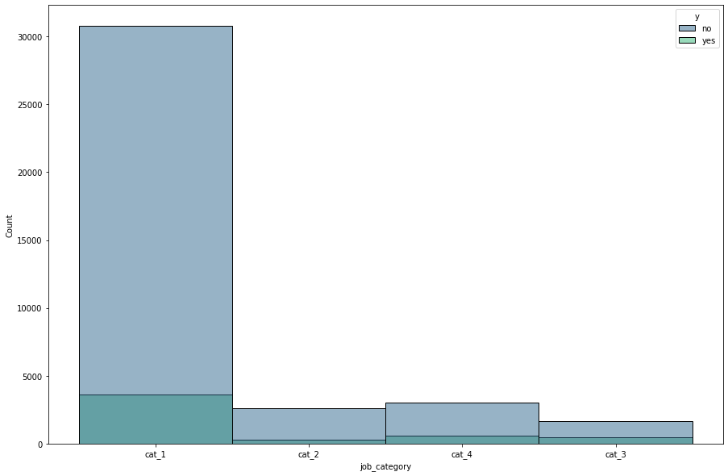
Feature Engineering
Performing Feature engineering for categorical columns by combining certain columns and labeling them under a certain category.
We can categorize jobs section by labeling them under various categories for example –
cat_1 – working-class clients.
cat_2 – self-employed, entrepreneurship.
cat_3 – retired.
cat_4 - not working.
It clearly shows us that the clients with category 1 jobs have subscribed the term deposit highest and category 2 is the lowest

Slide 20
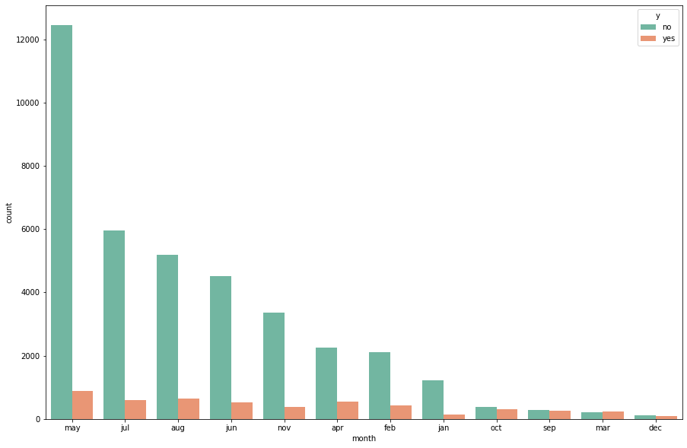
Feature Engineering (continue… )
It shows that april to august are the months when clients subscribe term deposits and during October to march clients don't often subscribe

Slide 21
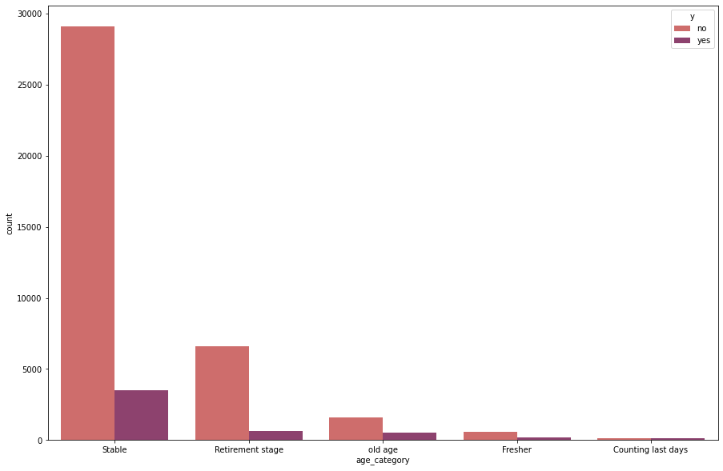
Feature Engineering (continue… )
Classification based on age category
age < 25 == 'Fresher'
age < 50 == 'Stable'
age < 59 == 'Retirement stage'
age < 75 == 'old age’
age > 75 == 'Counting last days’
We can clearly depict that the clients
with stable age are the ones who took
term deposits the most and those who
are counting last days are the least to
take term deposit.

Slide 22
Feature Engineering (continue… )
No one hot encoding for the month column instead assigning values for each month randomly
Since numerical columns are essential for implementing our machine-learning models we tend to convert the month column into some random numeric values for our reference
Dropping some of the columns since we have extracted new features from those columns
Converting minimum categorical values into numerical values for model implementation.

Slide 23
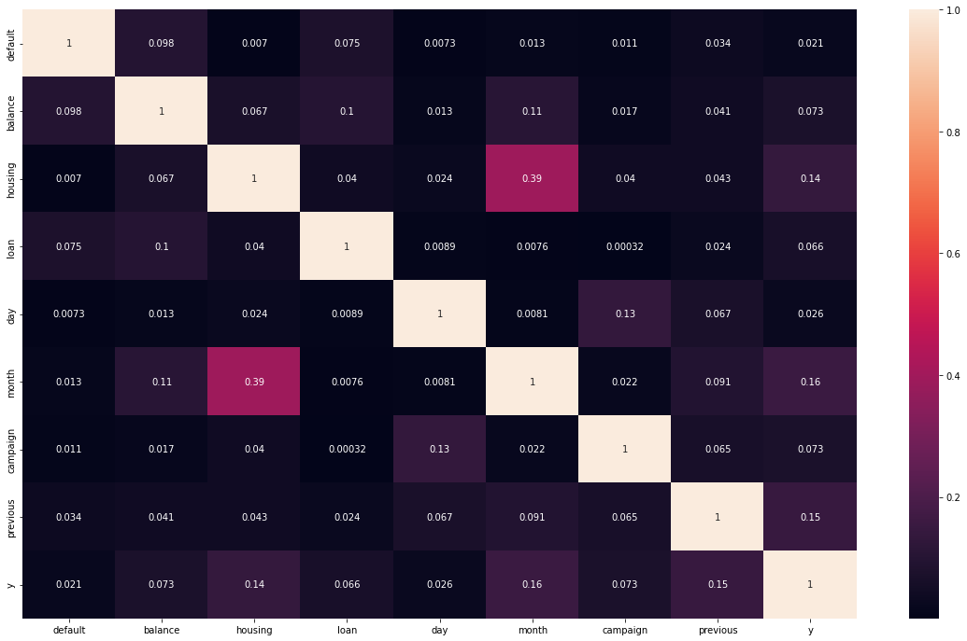
Correlation Map
Correlation map for final features selected for our model implementation

Slide 24
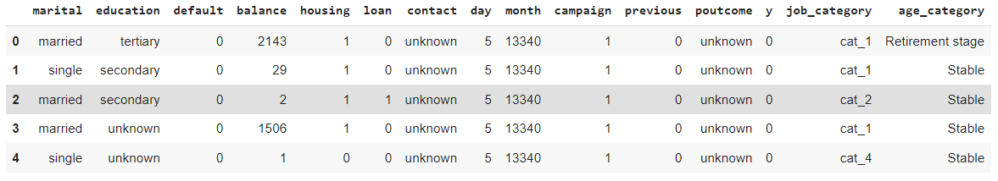
The final columns that we Consider after performing feature selection

Slide 25
Handling Class Imbalance
Synthetic Minority Oversampling Technique (SMOTE) is performed in our dataset to increase the number of cases in your dataset in a balanced way.
Original Dataset length == 43067 Resampled Dataset length == 76132

Slide 26
Machine Learning Model Implementation

Slide 27
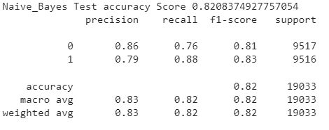
Naïve Bayes Model
We start off by implementing the Naïve Bayes model since it is the simplest model of all and also the most basic we couldn’t count on this model prediction but we consider this as our starting point.
Gaussian Naive Bayes model accuracy(in %): 82.08374927757053
The precision and recall values of our prediction tend to be quite accurate let’s move on to implementing further models

Slide 28
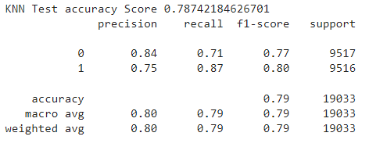
K- Nearest Neighbour Model Implementation
KNN model accuracy(in %): 78.80867691999399
Compared to our Naïve Bayes the Knn model has performed quite less but the precision and recall values tend to be highly correlated.

Slide 29
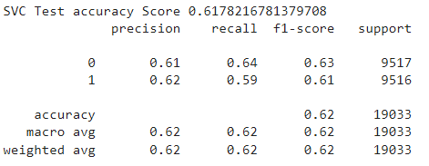
SVM Model
SVM model accuracy(in %): 61.78216781379709
The SVM model has produced very low accuracy compared to our previous models but the accuracy of the precision and recall is correlated.

Slide 30
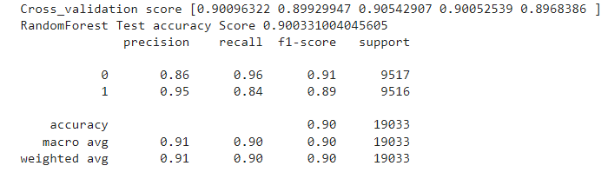
Random Forest
The Random forest classification model has helped us to classify our dataset in an effective way producing an accuracy of :
0.9049545526191352

Slide 31
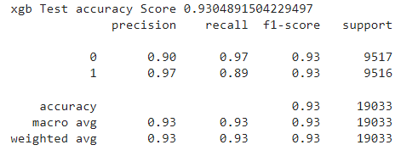
XG Boost
XG Boost Test accuracy Score 0.9318026585404298
So far xg boost has performed well compared to all models and hence we tend to perform hyperparameter tuning
xgb_hypertuned Test accuracy Score 0.9338517312036988

Slide 32
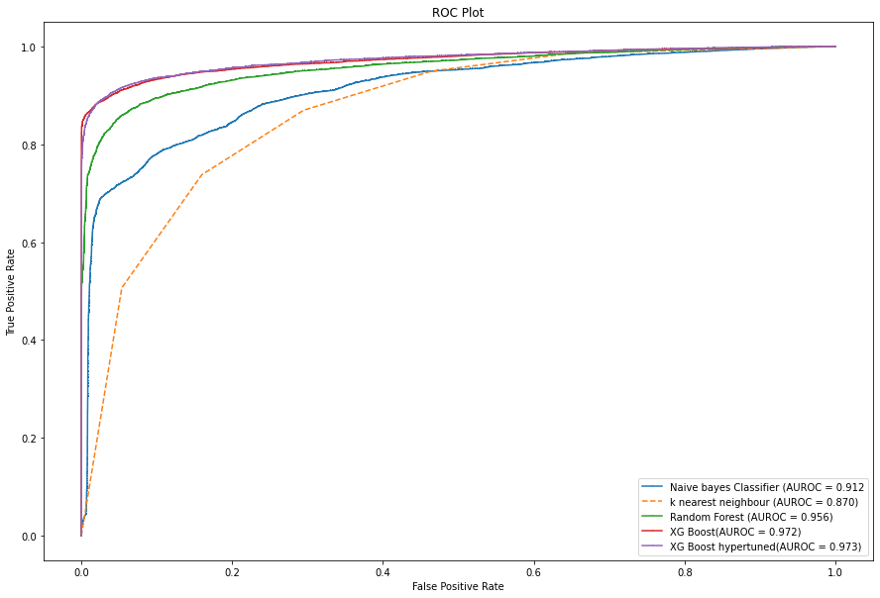
Computing AUROC and ROC curve values
Naive bayes : AUROC = 0.912
k nearest neighbour: AUROC = 0.870
Random Forest: AUROC = 0.956
xg boost: AUROC = 0.972
xg boost hypertuned: AUROC = 0.973

Slide 33
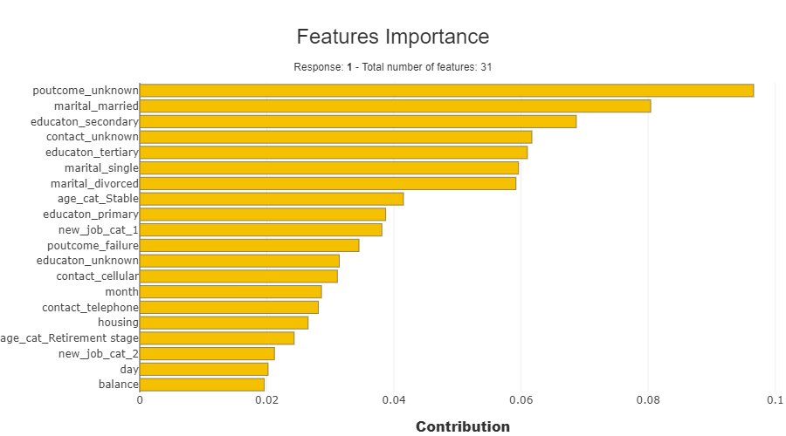
Feature Importance for final model (SHAPASH)
To Summarize and export the local explanation: Shapash proposes a short and clear local explanation. It allows each user, whatever their Data background is, to understand a local prediction of a supervised model.

Slide 34
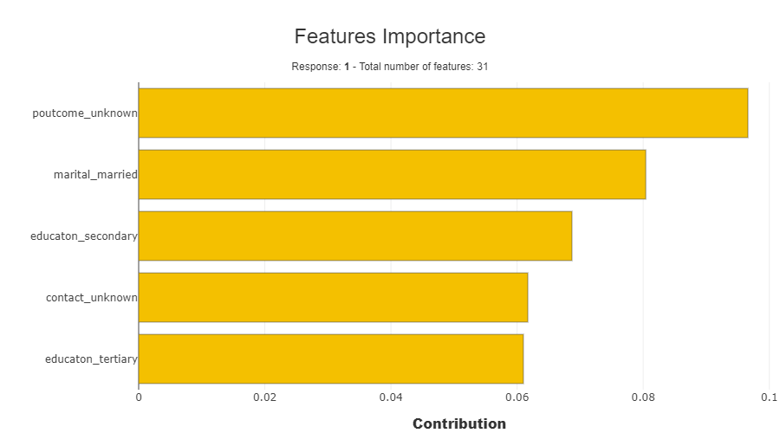
SHAPASH Model Explanatory (Continue..)
Client's age , Education, Job, Marital status, and outcome of the previous campaign are the most important features which the banks should focus for future campaigns.

Slide 35
CONCLUSION
So far we have implemented different machine learning models to predict whether people subscribe to a term deposit. From the evaluation metrics of the different models, we came to the conclusion that the accuracy of the XG boost ensemble model is the highest compared to the remaining models i.e Accuracy: 0.9318026585404298 is achieved.
Thus the best model is the XG boost ensemble and hence we tend to apply hyperparameter tuning and cross-validation for the same.

